Slide 1
BROWSER Stack CAPSTONEPROJECT
Under Guidance of Mrs. VaIshali sonanis Mam.

Slide 2
Introduction :
Browser Stack is a cloud testing platform that allows developers and testers to test websites and mobile applications across different browsers, operating systems, and real devices.

Slide 3
Responsibilities
Design and develop automated test scripts using Selenium AND CUCUMBER
Implement Page Object Model for maintainable test architecture
Execute all automated test cases using TeSTNG/CUCUMBER framework
Create defect reports.

Slide 4
Overview
What is BStack?
Browser Stack is a cloud-based testing platform that enables developers and testers to test websites and mobile applications on real browsers and devices without maintaining physical infrastructure.
My project is a demo setup using Browser Stack.
It helps users understand how cross-browser and cross-device testing works.
Browser Stack provides instant access to thousands of browsers, operating systems, and mobile devices.
It supports both manual and automated testing, with integrations for Selenium, TestNG, JUnit, Appium, and CI/CD tools.

Slide 5
Modules
Module 1 : Login
Checked the functionalities of username and password in the sign in page for login
Module 2 : ADD TO CART
Checked the functionality of add to cart button by adding an item to the cart.
Module 3 : DELETE
Checked the functionality of delete by deleting an item from the cart.

Slide 6
Module 4 : CHECKOUT
Checked the functionality of checkout by buying an item from the cart.
Module 5 : search MULTIPLE ITEMS
Checked the functionalities of search button by searching multiple items
Module 6 : shop By BRANDS
Checked the functionalities of vendors button by selecting different company phones
Module 7 : ORDER BY
Checked the functionality of order by button by changing lower to higher and
HIGHER TO LOWER.

Slide 7

Module 8 : FAVOURITES
Checked the functionality of favorites button by adding items to favorite .
Module 9 : OFFERS
Checked the functionality of offers button.
Module 10 : LOGOUT
Checked the functionality of logout button

Slide 8
Defects
Product images are not clickable
Search is not working

Slide 9
Defect identifier :- B_001
Defect summary :- when we click on "Search" Product list shows iPhone or related products but it is navigating to
HOME PAGE.
Test Id :- TC_001, TC_002, TC_003, TC_004,
Test case name :- Search_valid_productname,Search_Invalid, Search_partialkeyword , Search_emptykeyword
Ø Module name :- SEARCH
Ø Reproducible :-
Ø Severity :- medium
Ø Priority :- medium
Ø Raised by :- ROHITH
Ø Assigned to :- developer
Ø Date of assignment :-
Ø Status :- pending
Ø Snap shots :-
Ø Fixed by :- developer
Ø Date of fixing :-

Slide 10
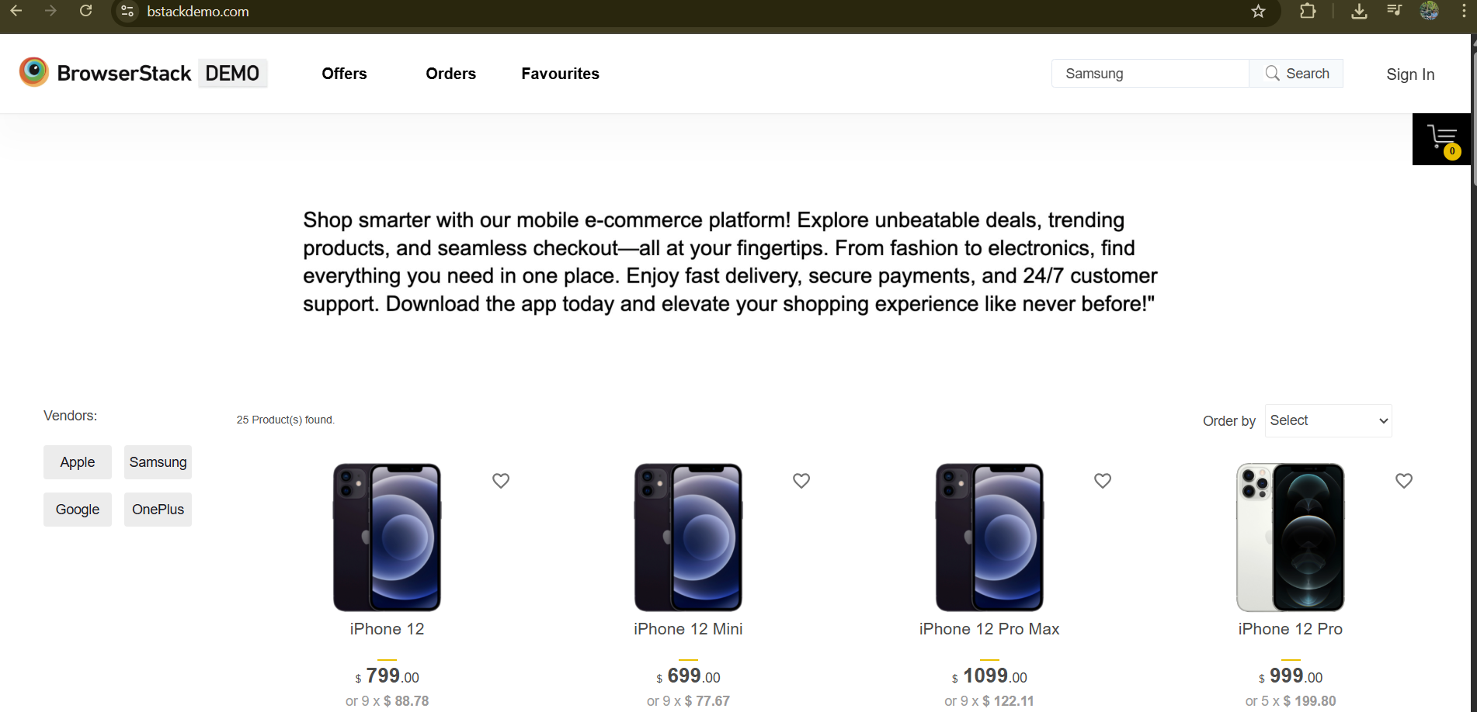
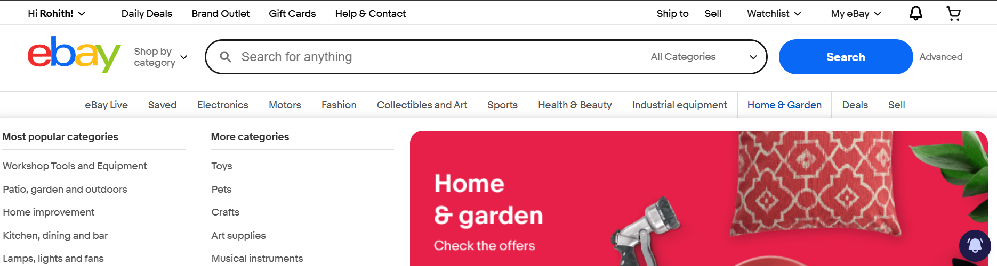
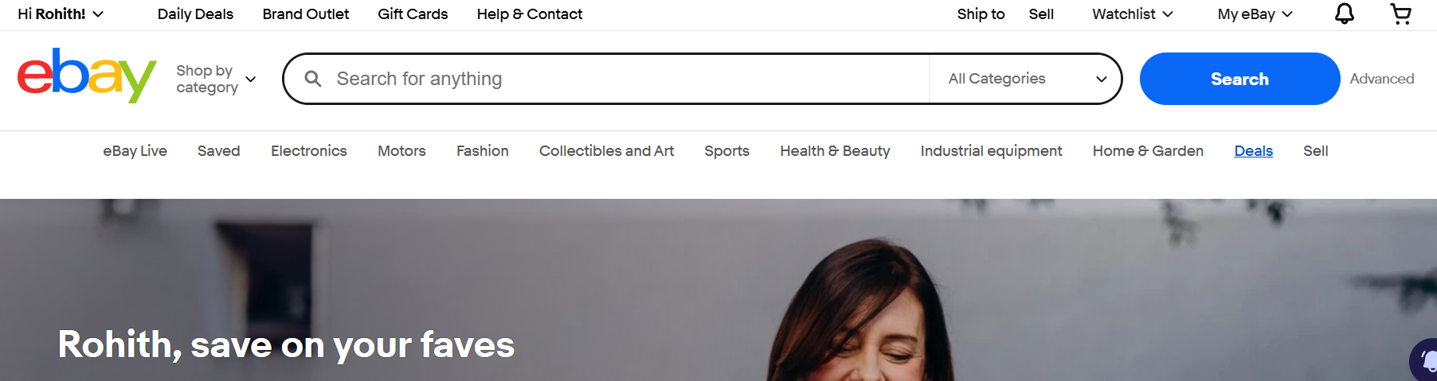
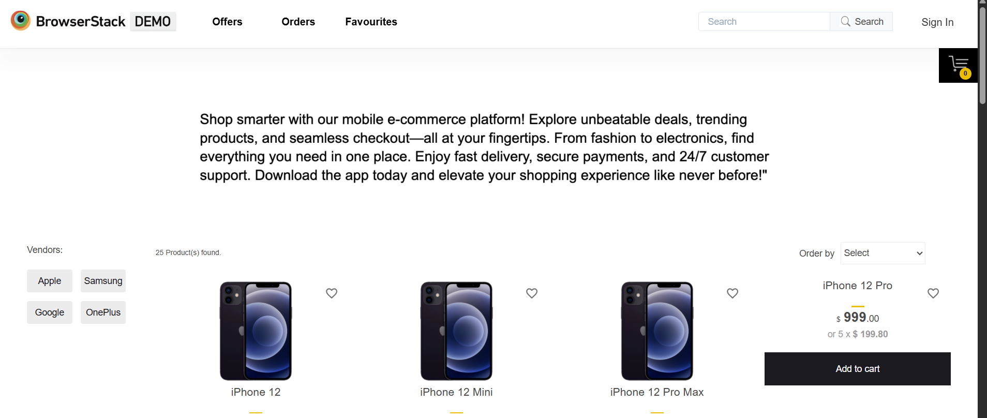

Slide 11
Defect identifier :- B_002
Defect summary :- Expected result is when we click on product image it need to redirect to
product details but it is not clickable
Test Id :- TC_001
Test case name :- ADD_TO_CART
Ø Module name :- ADD TO CART
Ø Reproducible :-
Ø Severity :- medium
Ø Priority :- medium
Ø Raised by :- ROHITH
Ø Assigned to :- developer
Ø Date of assignment :-
Ø Status :- pending
Ø Snap shots :-
Ø Fixed by :- developer
Ø Date of fixing :-

Slide 12
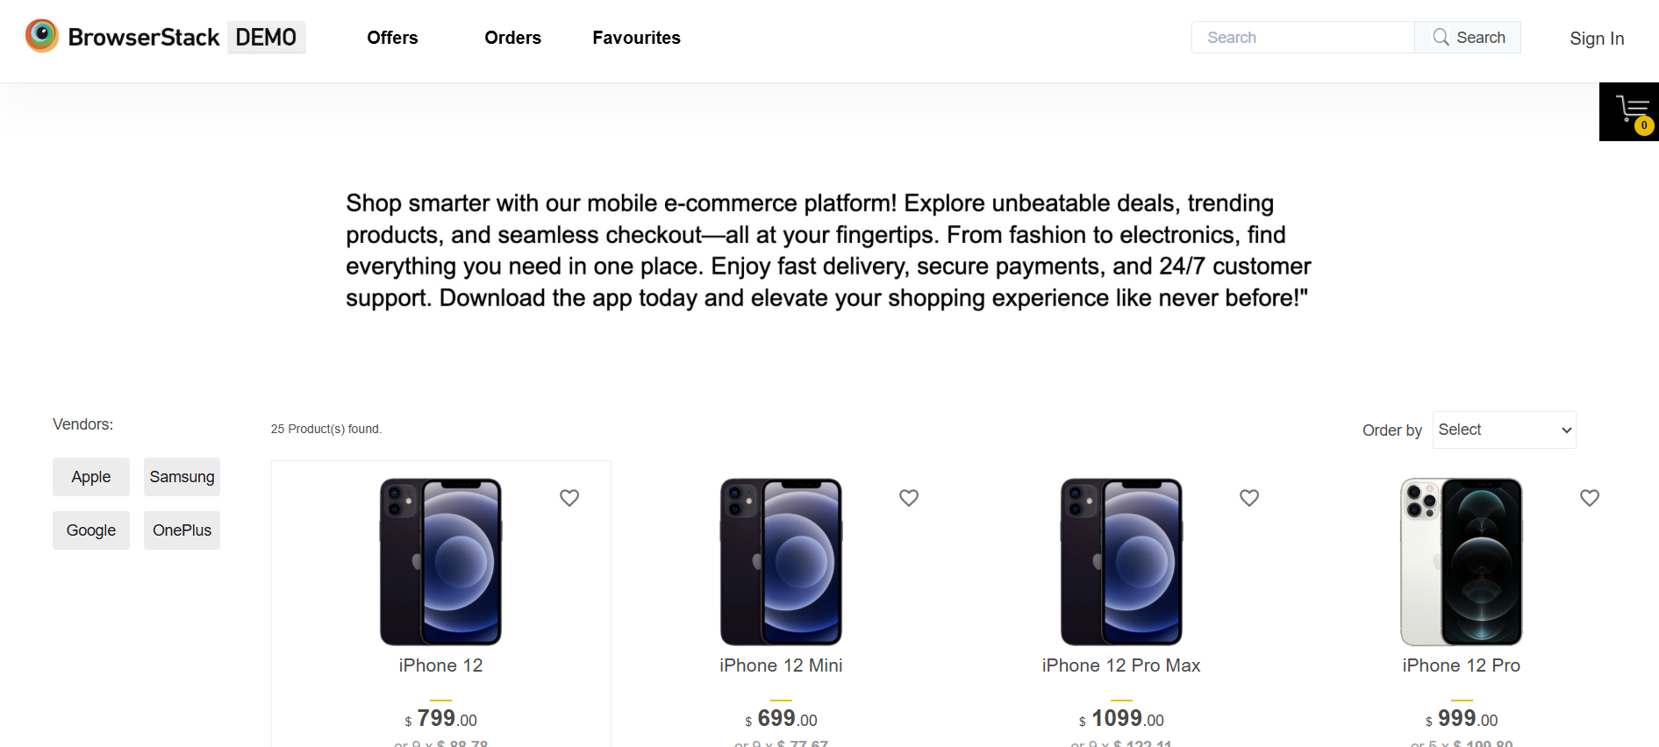

Slide 13
Challenges
Login module was bit difficult because of locators
SOMETIMES AUTOMATION FAILS BECAUSE OF UNSTABLE OR SLOW INTERNET.

Slide 14
Experience
Doing this project individually gave me full end-to-end exposure to automation testing.
I became much more confident with Selenium WebDriver after handling complex scenarios.
LEARNED TO WRITE AND EXECUTE AUTOMATION TEST CASES FOR PRODUCT LISTING, SEARCH, CART, AND CHECKOUT FLOWS..
Implementing the Page Object Model improved the way I structure and reuse my test code.

Slide 15
Thank You!!!
Vaishali Mam For Guiding Us through out the Project.

